Slide 1
ME759 High Performance Computing for Applications in Engineering [Spring 2020]
Lecture 05
01/31/2019
Dan Negrut, 2020 ME759 UW-Madison

Slide 2
Quote of the day
“English? Who needs that? I'm never going to England.”
-- Homer Simpson, Safety Inspector, anticipating Brexit [1989 - ]

Slide 3
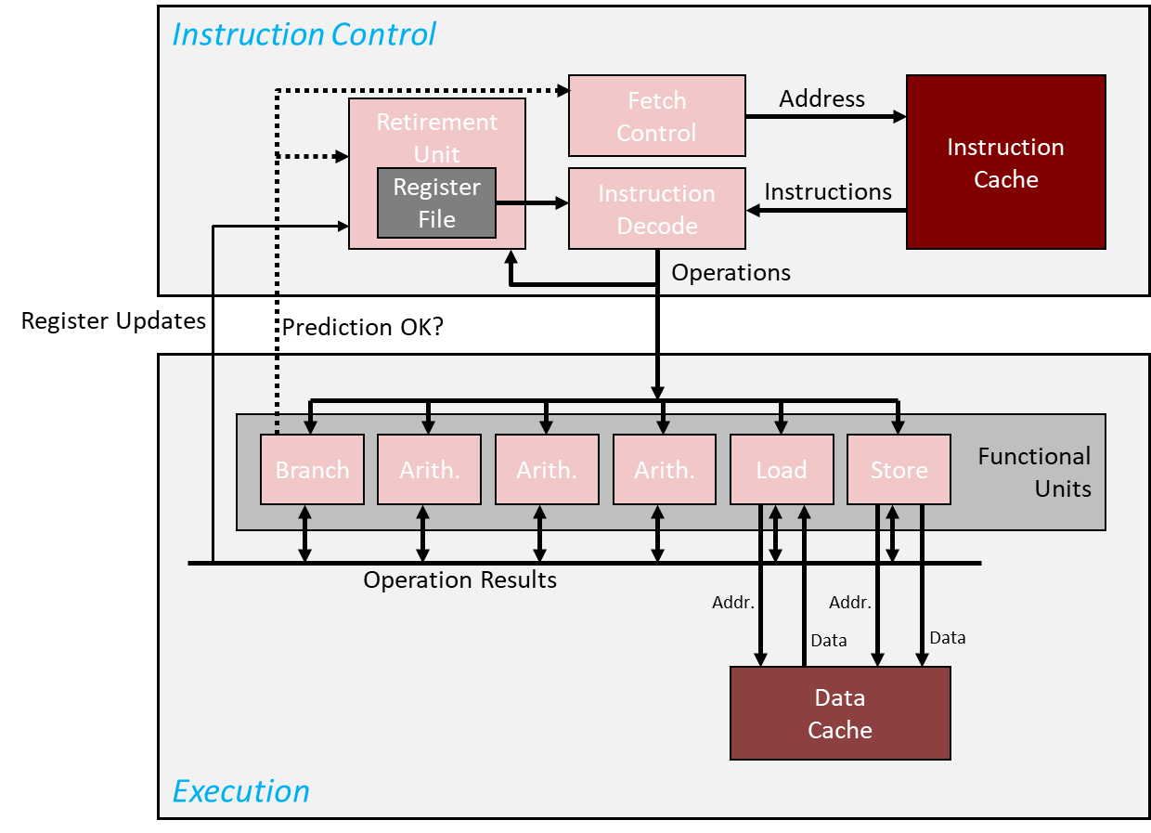
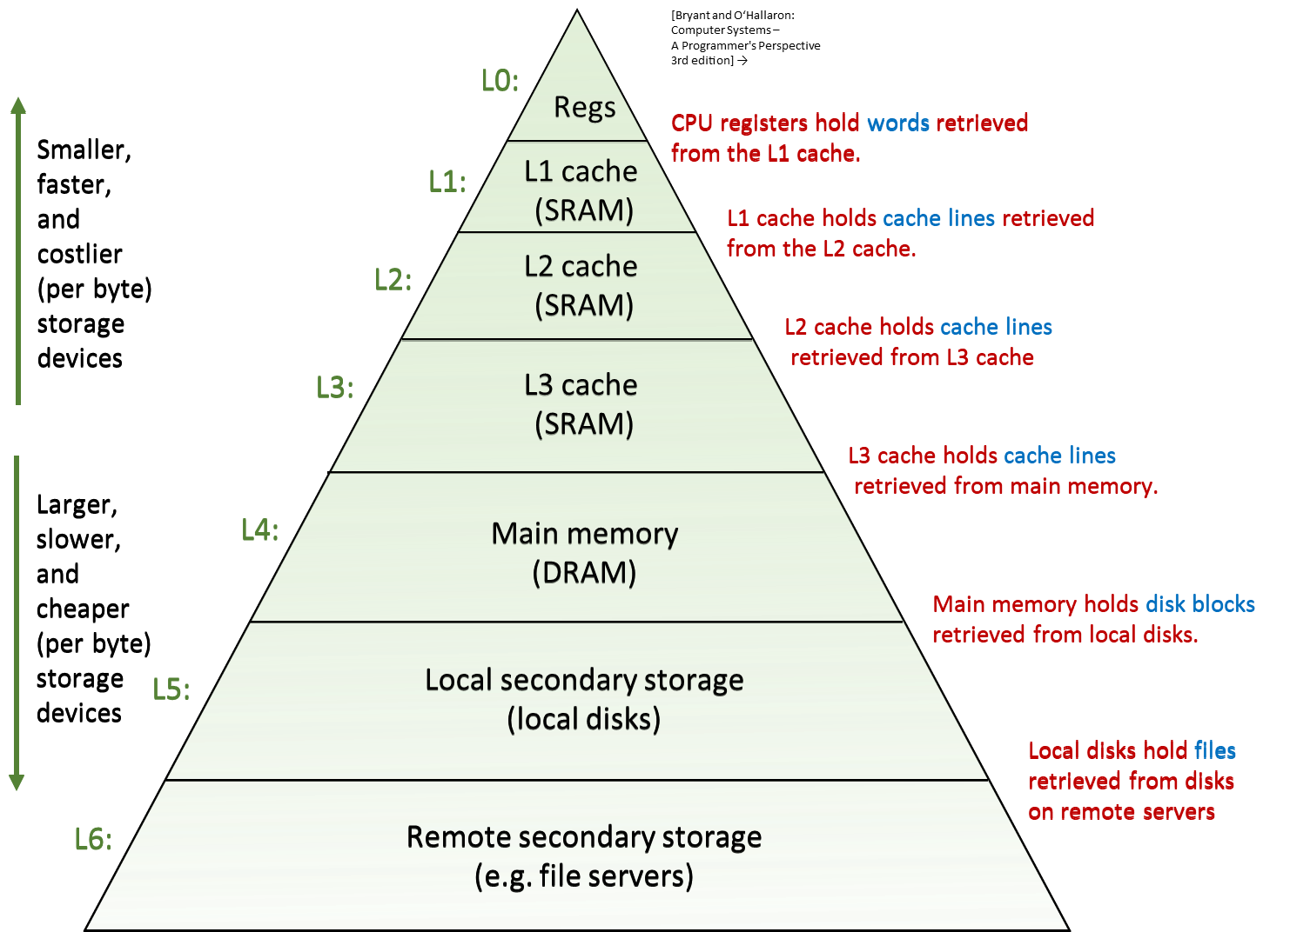
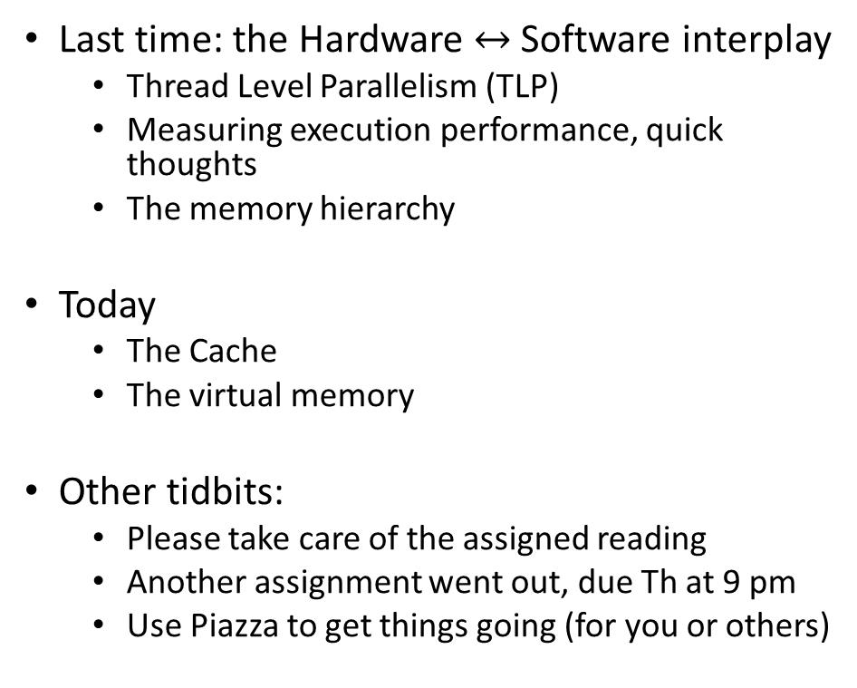
Before we get going…
Last time: the Hardware $↔$ Software interplay
Thread Level Parallelism (TLP)
Measuring execution performance, quick thoughts
The memory hierarchy
Today
The Cache
The virtual memory
Other tidbits:
Please take care of the assigned reading
Another assignment went out, due Th at 9 pm
Use Piazza to get things going (for you or others)

Slide 4
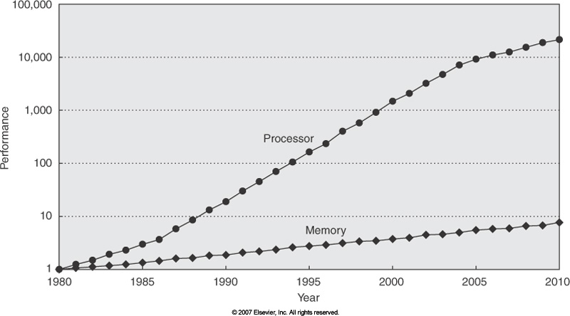
Memory Speed: Widening of the Processor-DRAM Speed Gap
Courtesy of Elsevier, Computer Architecture, Hennessey and Patterson, fourth edition
Notes:
QUESTION: we talk about memory wall as an impediment to continuing increase in sequential computing performance and we said that the problem is that memory cannot keep up feeding the raw number crunching capability of the CPU.
But then, how can parallel computing be the answer? How could memory serve now multiple “consumers” and yet overall performance increase?
To explain this, we note that memory performance is related to two key concepts:
latency
bandwidth

Slide 5
Cache Memories
Cache memories are small, fast, on-chip SRAM-based memories
Purpose: to store close to the CU/ALU frequently accessed blocks of main, or system, memory
Typical system structure:
CPU chip
Register file
ALU
Cache
memory
System bus
Memory bus
Main
memory
Bus interface
I/O
bridge
[Bryant and O‘Hallaron: CMU] →

Slide 6
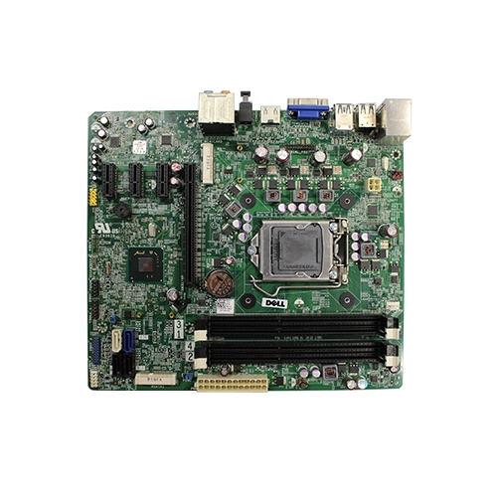

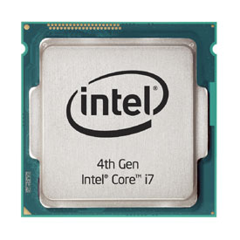
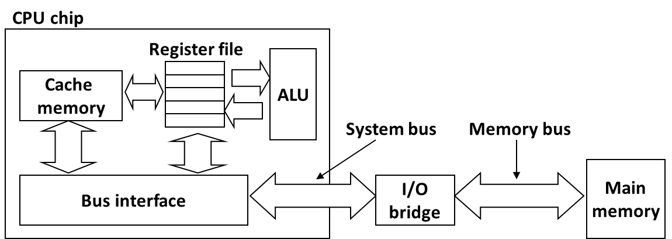
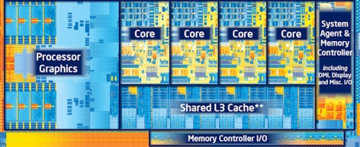
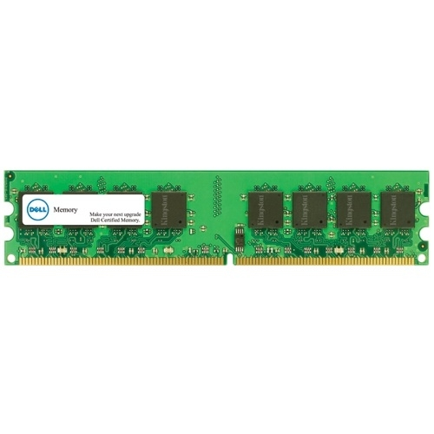
What it Really Looks Like
Motherboard
Source: Dell
Desktop PC
CPU (Intel Core i7)
Gets dropped in here
Source: PC Magazine
Source: Dell
Main memory (DRAM)
Source: techreport.com
Source: Dell
[Bryant and O‘Hallaron: CMU] →

Slide 7
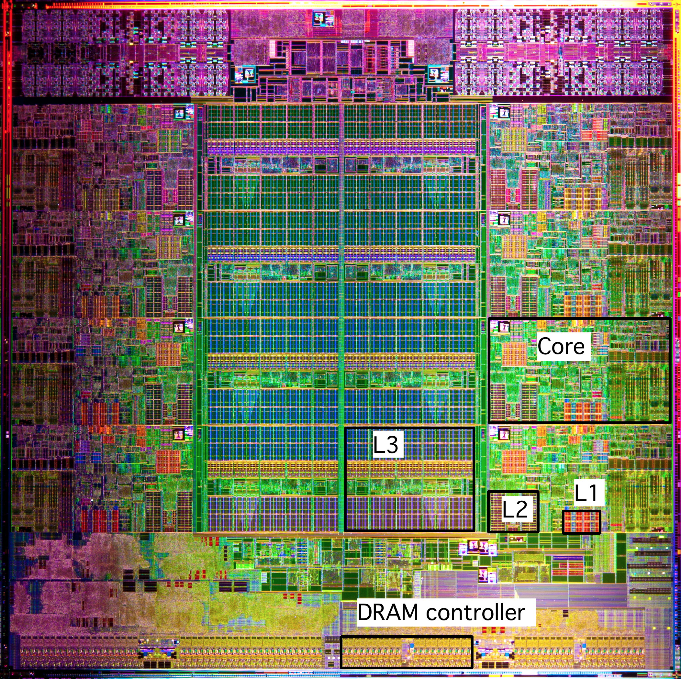
What it Really Looks Like [contd.]
Intel Sandy Bridge-E
Processor Die
[8 core-version]
CPU chip
Register file
ALU
Cache
memory
Bus interface
L1: 32KB Instruction + 32KB Data
L2: 256KB
L3: 5–20MB
[Bryant and O‘Hallaron: CMU] →

Slide 8
How Cache Comes into Play
All* read/write operations go through cache
Caches used to hold both data and instructions
Data and instructions caches are in general different
Intel: L1 DC (data cache) and L1 IC (instruction cache) have been distinct since of 1993
CPU Core
Cache
Bus
Main Memory

Slide 9
Caches: Come In Two Flavors
Data caches feed processor with data manipulated during execution
If processor would rely on data provided by main memory the execution would be pitifully slow
“Processor Clock” much faster than the “Memory Clock”
Caches alleviate the memory pressure – processors are data hungry
Instruction caches: used to store instructions
Simpler to deal with compared to the data caches
By and large, instruction use is much more predictable than data use

Slide 10
Processor Clock vs. Memory Clock
From RAM
Processor Clock: (look for the box )
Dictates/defines the frequency at which Functional Units operate
Memory Clock:
Dictates/defines the frequency used to move data into/out from main memory into cache
To/From RAM

Slide 11
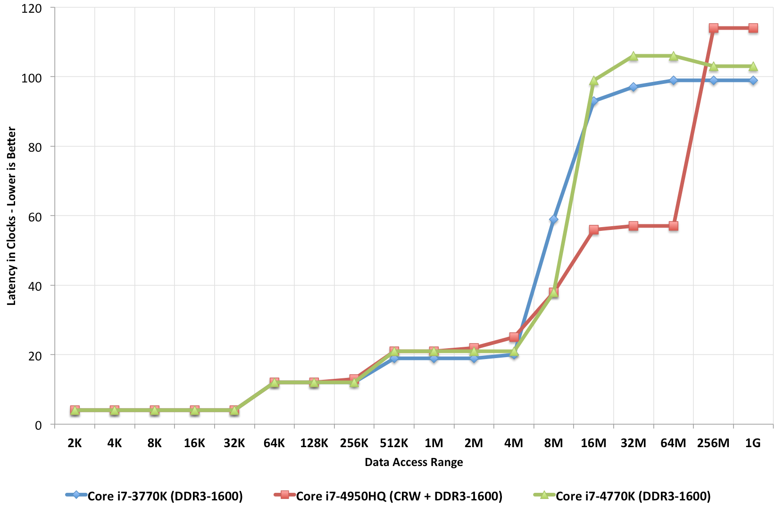
Caches: How large? Also, how fast?
Ratio between cache size and main memory size
Reasonable to expect something like 1:1000
2013: 4 MB of L3 cache, versus 4 GB of main memory
2017: 55 MB of L3 cache, versus 64 GB of main memory
This is the overhead of a system memory access (about 100+ cycles)
Vintage: 2013 (related to Intel’s Haswell)
Latency in Clocks –Lower is Better
This chip has L4 cache, read more about it here
(log scale)

Slide 12
Multiple Levels of Cache
Commodity chips today have 3 cache levels
(some chips have a fourth cache level, see previous slide)
CPU Core
L1 D$
L1 I$
L2 Cache
L3 Cache
Bus
Main Memory

Slide 13
Intel Core i7 Cache Hierarchy
Processor package
Core 0
Core 7
Regs
Regs
L1 i-cache and d-cache:
32 KB, 8-way assoc.
Access: 4 cycles
L2 unified cache:
256 KB, 8-way assoc.
Access: 10 cycles
L3 unified cache:
8 MB, 16-way assoc.
Access: 40-75 cycles
Block size: 64 bytes for all caches.
L1
d-cache
L1
i-cache
L1
d-cache
L1
i-cache
…
L2 unified cache
L2 unified cache
L3 unified cache
(shared by all cores)
Main memory
[Bryant and O‘Hallaron: Computer Systems - A Programmer's Perspective 3rd edition] →

Slide 14
Why Caches Work: the “Principle of Locality”
Principle of Locality: Programs tend to use data and instructions with addresses near or equal to those they have used recently
Temporal locality:
“Recently referenced items are likely to be referenced again in the near future”
Spatial locality:
“Items with nearby addresses tend to come into use together”
[Bryant and O‘Hallaron: Computer Systems - A Programmer's Perspective 3rd edition] →

Slide 15
Spatial and Temporal Locality
Temporal Locality for memory access by a program
Idea: If you access a variable at some time, then you’ll probably keep accessing the same variable for a while
Example: a for loop with some variables inside the loop → you keep accessing those variables as long as you loop
Spatial Locality for memory access by a program
A memory access pattern characterized by bursts of repeated requests for data that is physically located within the same memory region
“Bursts” because these accesses should happen in a sufficiently short interval of time (lest the cache line gets evicted)

Slide 16
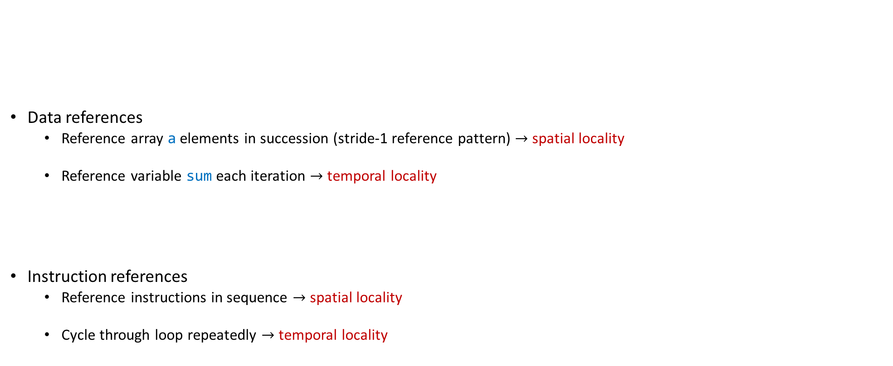
Example, regarding concept of “locality”
// some simple code snippet
sum = 0;
for (i = 0; i < n; i++)
sum += a[i];
return sum;
Data references
Reference array a elements in succession (stride-1 reference pattern) $→$ spatial locality
Reference variable sum each iteration $→$ temporal locality
Instruction references
Reference instructions in sequence $→$ spatial locality
Cycle through loop repeatedly $→$ temporal locality
[Bryant and O‘Hallaron: Computer Systems - A Programmer's Perspective 3rd edition] →

Slide 17
Example: Adding the Entries in a 2D Matrix
Example used over several slides to show how “locality” and caches impact performance
Very related to your second assignment

Slide 18
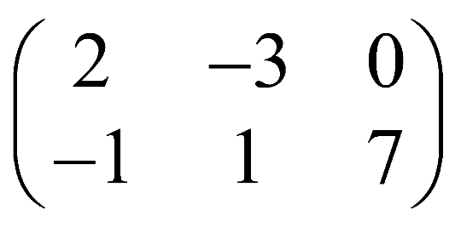
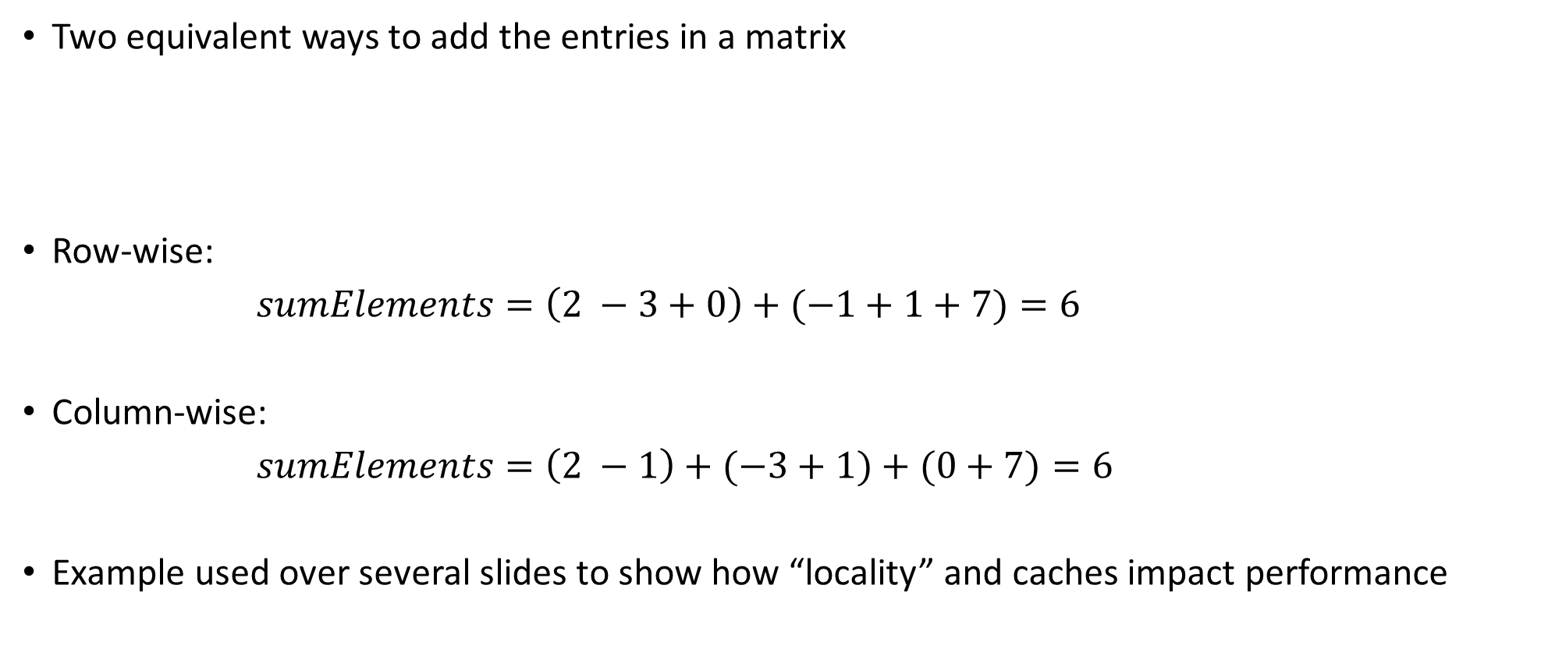
Example [motivation]: Adding the Entries in a 2D Matrix
Two equivalent ways to add the entries in a matrix
Row-wise:
$sumElements=\left(2 −3+0\right)+(−1+1+7)=6$
Column-wise:
$sumElements=\left(2 −1\right)+(−3+1)+(0+7)=6$
Example used over several slides to show how “locality” and caches impact performance
First row
Second row
First column
Second column
Third column

Slide 19
Squashed format vs. 2D format
Storing a matrix: squashed format OR 2D format
Example:
Squashed format – using one long contiguous array of 6 entries. Like in your homework
The 2D format – using two arrays:
Each has 3 entries
Each of the two arrays stored somewhere in the memory (they might be far from each other)

Slide 20
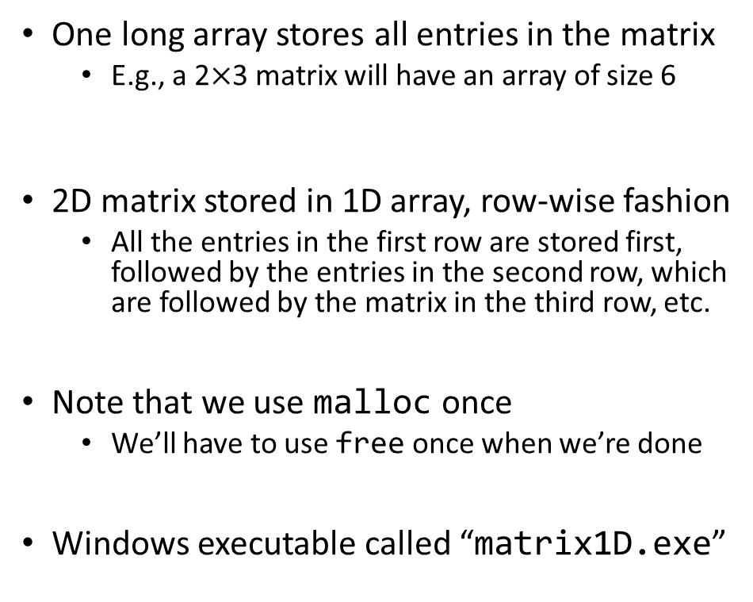
First way to represent 2D matrix: the “squashed,” 1D approach
#include <stdio.h>
#include <stdlib.h>
struct squashedMatrix {
/// 2D matrix stored row-wise in a one dimensional array
unsigned int height; /// number of rows in matrix
unsigned int width; /// number of columns in matrix
double *pMatVals;
};
int main() {
struct squashedMatrix mat1D;
mat1D.height = 1000; // perhaps you set this based on user input
mat1D.width = 2000; // perhaps you set this based on user input
mat1D.pMatVals = (double *)malloc(mat1D.height * mat1D.width * sizeof(double));
unsigned int i, j;
for (i = 0; i < mat1D.height; i++)
for (j = 0; j < mat1D.width; j++)
mat1D.pMatVals[i * mat1D.width + j] = 1. / (i + j + 1.);
// Compute sum of elements
double sum = 0.;
for (i = 0; i < mat1D.height; i++)
for (j = 0; j < mat1D.width; j++)
sum += mat1D.pMatVals[i * mat1D.width + j];
printf("The sum of the elements is: %f\n", sum);
// Done with the matrix; free the mem
free(mat1D.pMatVals);
return 0;
}
One long array stores all entries in the matrix
E.g., a 2$×$3 matrix will have an array of size 6
2D matrix stored in 1D array, row-wise fashion
All the entries in the first row are stored first, followed by the entries in the second row, which are followed by the matrix in the third row, etc.
Note that we use malloc once
We’ll have to use free once when we’re done
Windows executable called “matrix1D.exe”

Slide 21
A second way to represent the 2D matrix: the 2D approach
#include <stdio.h>
#include <stdlib.h>
struct Matrix2D {
/// 2D matrix stored row-wise in a one dimensional array
unsigned int height; /// number of rows in matrix
unsigned int width; /// number of columns in matrix
double **pRows;
};
int main() {
struct Matrix2D mat2D;
mat2D.height = 1000; // perhaps you set this based on user input
mat2D.width = 2000; // perhaps you set this based on user input
mat2D.pRows = (double **)malloc(mat2D.height * sizeof(double *));
unsigned int i;
for (i = 0; i < mat2D.height; i++)
mat2D.pRows[i] = (double *)malloc(mat2D.width * sizeof(double));
// Get meaningful values in this matrix
unsigned int j;
for (i = 0; i < mat2D.height; i++)
for (j = 0; j < mat2D.width; j++)
mat2D.pRows[i][j] = 1. / (i + j + 1.);
// Compute sum of elements
double sum = 0;
for (i = 0; i < mat2D.height; i++)
for (j = 0; j < mat2D.width; j++)
sum += mat2D.pRows[i][j];
printf("The sum of the elements is: %f\n", sum);
// Don't data anymore, free mem; note that free is used twice
for (i = 0; i < mat2D.height; i++)
free(mat2D.pRows[i]);
free(mat2D.pRows);
return 0;
}
First we allocate room to store a number of pointers to double
There are “height” of these “double *” pointers
These pointers stored in the array pRows
For each matrix row (and there are “height” of them), we allocate enough room to store “width” doubles
These are the values that show up in a row of the matrix
Note that I use malloc multiple times
We’ll have to use free multiple times
Windows executable called “matrix2D.exe”

Slide 22
The squashed approach, revisited: locality vs. non-locality
#include <Windows.h> // need this for timing
#include <stdio.h>
#include <stdlib.h>
struct squashedMatrix {
/// 2D matrix stored row-wise in a one dimensional array
unsigned int height; /// number of rows in matrix
unsigned int width; /// number of columns in matrix
double *pMatVals;
};
int main(int argc, char *argv[]) {
if (argc != 2) {
printf("Pass 1 for row-wise, pass 2 for column-wise sum.\n");
return 1;
}
int option = atoi(argv[1]);
struct squashedMatrix mat1D;
mat1D.height = 2000; // perhaps you set this based on user input
mat1D.width = 2000; // perhaps you set this based on user input
mat1D.pMatVals = (double *)malloc(mat1D.height * mat1D.width * sizeof(double));
unsigned int i, j;
for (i = 0; i < mat1D.height; i++)
for (j = 0; j < mat1D.width; j++)
mat1D.pMatVals[i * mat1D.width + j] = 1. / (i + j + 1.);
// Compute sum of elements
double sum = 0.;
__int64 ctr1 = 0, ctr2 = 0, freq = 0; // need this for timing
if (QueryPerformanceCounter((LARGE_INTEGER *)&ctr1) != 0) {
if (option == 1) {
for (i = 0; i < mat1D.height; i++)
for (j = 0; j < mat1D.width; j++)
sum += mat1D.pMatVals[i * mat1D.width + j];
} else if (option == 2) {
for (j = 0; j < mat1D.width; j++) {
for (i = 0; i < mat1D.height; i++)
sum += mat1D.pMatVals[i * mat1D.width + j];
}
} else {
printf("Bad input option.\n");
return 1;
}
QueryPerformanceCounter((LARGE_INTEGER *)&ctr2);
QueryPerformanceFrequency((LARGE_INTEGER *)&freq);
}
printf("The sum of the elements is: %f\n", sum);
printf("Time spent in microseconds: %f\n", (ctr2 - ctr1) * 1.0 / freq);
// Done with the matrix; free the mem
free(mat1D.pMatVals);
return 0;
}

Slide 23
Results, release build: 6 to 7 times faster if accessed w/ locality
TRUMAN Release> ./matrixRep1D.exe
Pass 1 for row-wise, pass 2 for column-wise sum.
TRUMAN Release>
TRUMAN Release>
TRUMAN Release> ./matrixRep1D.exe 1
The sum of the elements is: 2772.088785
Time spent in microseconds: 0.003622
TRUMAN Release>
TRUMAN Release>
TRUMAN Release> ./matrixRep1D.exe 2
The sum of the elements is: 2772.088785
Time spent in microseconds: 0.023060
TRUMAN Release>
OS Name Microsoft Windows 10 Enterprise 2016 LTSB
System Type x64-based PC
Processor Intel(R) Core(TM) i7-6800K CPU @ 3.40GHz, 3401 Mhz, 6 Core(s), 12 Logical Processor(s)
Installed Physical Memory (RAM) 32.0 GB
Compiler Visual Studio 2015 (Enterprise)

Slide 24
The 2D approach, revisited: locality vs. non-locality
#include <Windows.h> // need this for timing
#include <stdio.h>
#include <stdlib.h>
struct Matrix2D {
/// 2D matrix stored row-wise in a one dimensional array
unsigned int height; /// number of rows in matrix
unsigned int width; /// number of columns in matrix
double **pRows;
};
int main(int argc, char *argv[]) {
if (argc != 2) {
printf("Pass 1 for row-wise, pass 2 for column-wise sum.\n");
return 1;
}
int option = atoi(argv[1]);
struct Matrix2D mat2D;
mat2D.height = 2000; // perhaps you set this based on user input
mat2D.width = 2000; // perhaps you set this based on user input
mat2D.pRows = (double **)malloc(mat2D.height * sizeof(double *));
unsigned int i;
for (i = 0; i < mat2D.height; i++)
mat2D.pRows[i] = (double *)malloc(mat2D.width * sizeof(double));
// Get meaningful values in this matrix
unsigned int j;
for (i = 0; i < mat2D.height; i++)
for (j = 0; j < mat2D.width; j++)
mat2D.pRows[i][j] = 1. / (i + j + 1.);
// Compute sum of elements
double sum = 0;
__int64 ctr1 = 0, ctr2 = 0, freq = 0; // need this for timing
if (QueryPerformanceCounter((LARGE_INTEGER *)&ctr1) != 0) {
if (option == 1) {
for (i = 0; i < mat2D.height; i++)
for (j = 0; j < mat2D.width; j++)
sum += mat2D.pRows[i][j];
} else if (option == 2) {
for (j = 0; j < mat2D.width; j++)
for (i = 0; i < mat2D.height; i++)
sum += mat2D.pRows[i][j];
} else {
printf("Bad input option.\n");
return 1;
}
QueryPerformanceCounter((LARGE_INTEGER *)&ctr2);
QueryPerformanceFrequency((LARGE_INTEGER *)&freq);
}
printf("The sum of the elements is: %f\n", sum);
printf("Time spent in microseconds: %f\n", (ctr2 - ctr1) * 1.0 / freq);
// Don't data anymore, free mem; note that free is used twice
for (i = 0; i < mat2D.height; i++)
free(mat2D.pRows[i]);
free(mat2D.pRows);
return 0;
}

Slide 25
Results, release build: $≈$ 5 times faster if accessed w/ locality
TRUMAN Release> ./matrixRep2D.exe
Pass 1 for row-wise, pass 2 for column-wise sum.
TRUMAN Release>
TRUMAN Release>
TRUMAN Release> ./matrixRep2D.exe 1
The sum of the elements is: 2772.088785
Time spent in microseconds: 0.004075
TRUMAN Release>
TRUMAN Release>
TRUMAN Release> ./matrixRep2D.exe 2
The sum of the elements is: 2772.088785
Time spent in microseconds: 0.020078
TRUMAN Release>
OS Name Microsoft Windows 10 Enterprise 2016 LTSB
System Type x64-based PC
Processor Intel(R) Core(TM) i7-6800K CPU @ 3.40GHz, 3401 Mhz, 6 Core(s), 12 Logical Processor(s)
Installed Physical Memory (RAM) 32.0 GB
Compiler Visual Studio 2015 (Enterprise)

Slide 26
The two scenarios, side by side: squashed and proper 2D
TRUMAN Release> ./matrixRep1D.exe
Pass 1 for row-wise, pass 2 for column-wise sum.
TRUMAN Release>
TRUMAN Release>
TRUMAN Release> ./matrixRep1D.exe 1
The sum of the elements is: 2772.088785
Time spent in microseconds: 0.003622
TRUMAN Release>
TRUMAN Release>
TRUMAN Release> ./matrixRep1D.exe 2
The sum of the elements is: 2772.088785
Time spent in microseconds: 0.023060
TRUMAN Release>
TRUMAN Release> ./matrixRep2D.exe
Pass 1 for row-wise, pass 2 for column-wise sum.
TRUMAN Release>
TRUMAN Release>
TRUMAN Release> ./matrixRep2D.exe 1
The sum of the elements is: 2772.088785
Time spent in microseconds: 0.004075
TRUMAN Release>
TRUMAN Release>
TRUMAN Release> ./matrixRep2D.exe 2
The sum of the elements is: 2772.088785
Time spent in microseconds: 0.020078
TRUMAN Release>
OS Name Microsoft Windows 10 Enterprise 2016 LTSB
System Type x64-based PC
Processor Intel(R) Core(TM) i7-6800K CPU @ 3.40GHz, 3401 Mhz, 6 Core(s), 12 Logical Processor(s)
Installed Physical Memory (RAM) 32.0 GB
Compiler Visual Studio 2015 (Enterprise)

Slide 27
Final Exam type question: Qualitative Estimates of Locality
Being able to look at code and get a qualitative sense of its locality is a key skill for a professional programmer
Question: Below, do we have good locality with respect to array a?
int sum_array_rows(int** a)
{
int i, j, sum = 0;
for (i = 0; i < M; i++)
for (j = 0; j < N; j++)
sum += a[i][j];
return sum;
}
[Bryant and O‘Hallaron: Computer Systems - A Programmer's Perspective 3rd edition] →

Slide 28
Final Exam type question: Qualitative Estimates of Locality
Question: Does this function have good locality with respect to array a?
int sum_array_cols(int** a)
{
int i, j, sum = 0;
for (j = 0; j < N; j++)
for (i = 0; i < M; i++)
sum += a[i][j];
return sum;
}
[Bryant and O‘Hallaron: Computer Systems - A Programmer's Perspective 3rd edition] →

Slide 29
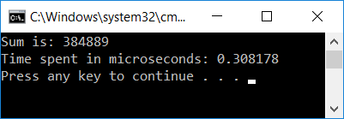
Taking it to the next level: 3D Matrices – good locality
OS Name Microsoft Windows 10 Enterprise 2016 LTSB
System Type x64-based PC
Processor Intel(R) Core(TM) i7-6800K CPU @ 3.40GHz, 3401 Mhz, 6 Core(s), 12 Logical Processor(s)
Installed Physical Memory (RAM) 32.0 GB
Compiler Visual Studio 2015 (Enterprise)
#include<iostream>
#include<Windows.h> // need this for timing
int main() {
const int M = 700;
__int64 ctr1 = 0, ctr2 = 0, freq = 0; // need this for timing
double*** bPPP; // use this to store values
bPPP = (double***)malloc(M * sizeof(double**));
for (int i = 0; i < M; i++) {
bPPP[i] = (double**)malloc(M * sizeof(double*));
for (int j = 0; j < M; j++) {
bPPP[i][j] = (double*)malloc(M * sizeof(double));
for (int k = 0; k < M; k++)
bPPP[i][j][k] = 1. / (i + j + k + 1.); // storing some smallish number
}
}
double sum = 0.;
if (QueryPerformanceCounter((LARGE_INTEGER *)&ctr1) != 0) {
// sum up all entries in 3D array
for (int i = 0; i < M; i++)
for (int j = 0; j < M; j++)
for (int k = 0; k < M; k++)
sum += bPPP[i][j][k];
QueryPerformanceCounter((LARGE_INTEGER *)&ctr2);
QueryPerformanceFrequency((LARGE_INTEGER *)&freq);
}
std::cout << "Sum is: " << sum << std::endl;
std::cout << "Time spent in microseconds: " << ((ctr2 - ctr1) * 1.0 / freq) << std::endl;
return 0;
}

Slide 30
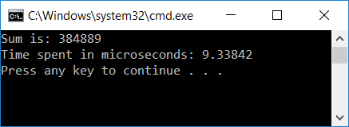
Taking it to the next level: 3D Matrices – bad locality
OS Name Microsoft Windows 10 Enterprise 2016 LTSB
System Type x64-based PC
Processor Intel(R) Core(TM) i7-6800K CPU @ 3.40GHz, 3401 Mhz, 6 Core(s), 12 Logical Processor(s)
Installed Physical Memory (RAM) 32.0 GB
Compiler Visual Studio 2015 (Enterprise)
#include<iostream>
#include<Windows.h> // need this for timing
int main() {
const int M = 700;
__int64 ctr1 = 0, ctr2 = 0, freq = 0; // need this for timing
double*** bPPP; // use this to store values
bPPP = (double***)malloc(M * sizeof(double**));
for (int i = 0; i < M; i++) {
bPPP[i] = (double**)malloc(M * sizeof(double*));
for (int j = 0; j < M; j++) {
bPPP[i][j] = (double*)malloc(M * sizeof(double));
for (int k = 0; k < M; k++)
bPPP[i][j][k] = 1. / (i + j + k + 1.); // storing some smallish number
}
}
double sum = 0.;
if (QueryPerformanceCounter((LARGE_INTEGER *)&ctr1) != 0) {
// sum up all entries in 3D array
for (int k = 0; k < M; k++)
for (int j = 0; j < M; j++)
for (int i = 0; i < M; i++)
sum += bPPP[i][j][k];
QueryPerformanceCounter((LARGE_INTEGER *)&ctr2);
QueryPerformanceFrequency((LARGE_INTEGER *)&freq);
}
std::cout << "Sum is: " << sum << std::endl;
std::cout << "Time spent in microseconds: " << ((ctr2 - ctr1) * 1.0 / freq) << std::endl;
return 0;
}

Slide 31
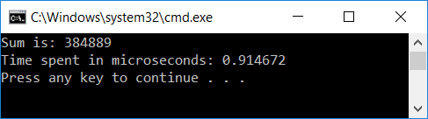
Running the code in Debug vs. Release mode: big difference?
OS Name Microsoft Windows 10 Enterprise 2016 LTSB
System Type x64-based PC
Processor Intel(R) Core(TM) i7-6800K CPU @ 3.40GHz, 3401 Mhz, 6 Core(s), 12 Logical Processor(s)
Installed Physical Memory (RAM) 32.0 GB
Compiler Visual Studio 2015 (Enterprise)
#include<iostream>
#include<Windows.h> // need this for timing
int main() {
const int M = 700;
__int64 ctr1 = 0, ctr2 = 0, freq = 0; // need this for timing
double*** bPPP; // use this to store values
bPPP = (double***)malloc(M * sizeof(double**));
for (int i = 0; i < M; i++) {
bPPP[i] = (double**)malloc(M * sizeof(double*));
for (int j = 0; j < M; j++) {
bPPP[i][j] = (double*)malloc(M * sizeof(double));
for (int k = 0; k < M; k++)
bPPP[i][j][k] = 1. / (i + j + k + 1.); // storing some smallish number
}
}
double sum = 0.;
if (QueryPerformanceCounter((LARGE_INTEGER *)&ctr1) != 0) {
// sum up all entries in 3D array
for (int i = 0; i < M; i++)
for (int j = 0; j < M; j++)
for (int k = 0; k < M; k++)
sum += bPPP[i][j][k];
QueryPerformanceCounter((LARGE_INTEGER *)&ctr2);
QueryPerformanceFrequency((LARGE_INTEGER *)&freq);
}
std::cout << "Sum is: " << sum << std::endl;
std::cout << "Time spent in microseconds: " << ((ctr2 - ctr1) * 1.0 / freq) << std::endl;
return 0;
}
“Debug” mode
“Release” mode

Slide 32
Three observations related to our 2D and 3D examples
Observation 1: Final value for sum - stays the same (at least as far as we can tell)
We’ll talk more about this when we do parallel computing w/ CUDA and then OpenMP
Observation 2: Difference between Debug vs Release builds
3X to 4X speedup normal to see when going from debug to release (see also results on next slide)
Observation 3: Amount of time to get the result quite different
Release mode build: the undesirable solution for 3D matrix is 30 times slower
This is the case you see in practice – you build in release

Slide 33
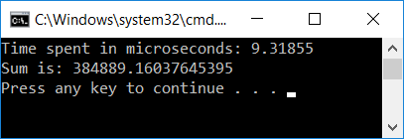
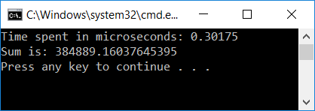
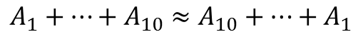
Observations on “Observation 1”
The fact that the results are the same is remarkable
Why remarkable?
Finite precision arithmetic: addition loses its commutative and associative attributes
Because of finite precision
$$A_{1}+…+A_{10}≈A_{10}+…+A_{1}$$
$${((…((A}_{1}+A_{2})+A_{3})+A_{4})+…+A_{10})≈{(A}_{1}+{(A}_{2}+(…+(A_{9}+A_{10}))…))$$
Because of finite precision

Slide 34
Observations on “Observation 3” (most important)
First time in 759 discussing how to improve performance
This type of gain; i.e., 30X speed up, not encountered every day…
Q: What mechanism comes into play to yield a 30X speed gain?
A: The cache
L1 cache: 4 cycles
System memory access: 120 cycles

Slide 35
Indirection and how it’s hurting… An example. [one slide side trip]
Indirection: given an index i, you don’t need a[i]
Rather, you need a[indir[i]] (this is one level of indirection; can go higher yet…)
What’s hurting here?
First, when stride is large, you index into an array indir of non-negative integers but keep missing
No locality…
Second, you will subsequently jump in the array a all over the place
Very likely you’ll just keep missing
Unfortunately, indirection in computing really common
void loop(int* a, unsigned int* indir, int N, int stride)
{
int sum = 0;
for (int i = 0; i < N; i+=stride)
sum += a[indir[i]];
}

Slide 36
The Lesson Learned
Fact: Wide gap between using data and moving data
Using data: you do sin of that data, log, pow, add, subtract, etc. (processing the data)
Moving data: getting your data from the system memory (64 GB/128/etc. GB that you have on your system)
Fact: The cache used to close the big speed gap
Trait of well-written programs: they manage to leverage data/instruction locality
Locality is what allows caches to come into play
Locality necessary, but not sufficient (more later, “false sharing”)

Slide 37
Memory Speed: Widening of the Processor-DRAM Speed Gap
Courtesy of Elsevier, Computer Architecture, Hennessey and Patterson, fourth edition
Notes:
QUESTION: we talk about memory wall as an impediment to continuing increase in sequential computing performance and we said that the problem is that memory cannot keep up feeding the raw number crunching capability of the CPU.
But then, how can parallel computing be the answer? How could memory serve now multiple “consumers” and yet overall performance increase?
To explain this, we note that memory performance is related to two key concepts:
latency
bandwidth

Slide 38
[Back to caches: The inner workings of caches] General Cache Concepts
Everything handled in hardware. Invisible to programmer
Smaller, faster, more expensive
memory can store a subset of
the main memory blocks
The Cache
8
4
9
14
10
3
Data copied in block-sized transfer units. Each block (such as block 10, for instance) typically holds 64 bytes of data (called cache line).
4
10
0
1
2
3
4
4
5
6
7
8
9
10
The Main Memory
10
11
Main Memory: Larger, slower, cheaper memory
(shown here as partitioned into “blocks” that are
mapped into cache lines)
12
13
14
15
[Bryant and O‘Hallaron: Computer Systems - A Programmer's Perspective 3rd edition] →

Slide 39
Cache Line (aka Cache Block)
When data is brought in cache because a piece of data is needed, the MMU brings more than just the needed piece of data
Why bring more data than what absolutely necessary?
Reason 1: In anticipation – recall principle of spatial locality
You’ll likely need data that is right next to data that you just called for
Reason 2: Because penalty is not high for bringing more: wide buses, little extra cost in bringing more data than exactly what needed
For instance, NVIDIA hardware has 32 lanes for bringing data; it’s not like if you bring a bit more you have to pay significantly more
“cache line” - the size of the chunk of data brought from main memory and deposited into cache
Many systems have cache line of 64 Bytes (8 doubles OR 16 floats OR 16 ints OR 64 chars, etc.)
Cache line size is typically the same for L1, L2 and L3 caches

Slide 40
General Cache Concepts: Hit
Delivery to registers…
Request: 14
Data in block b is needed
Block b is in cache:
Hit!
Cache
8
9
14
3
14
Memory
0
1
2
3
4
5
6
7
8
9
10
11
Hit Rate: on average, how many out of 100 mem requests hit the cache?
12
13
14
15
[Bryant and O‘Hallaron: Computer Systems - A Programmer's Perspective 3rd edition] →

Slide 41
General Cache Concepts: Miss
Delivery to registers…
Request: 12
Data in block b is needed
Block b is not in cache:
Miss!
Cache
8
9
14
3
12
Block b is fetched from
memory
12
Request: 12
Memory
0
1
2
3
Block b is stored in cache
Placement policy: determines where Block b goes
Replacement policy: determines which block gets evicted (victim)
4
5
6
7
8
9
10
11
12
12
13
14
15
[Bryant and O‘Hallaron: Computer Systems - A Programmer's Perspective 3rd edition] →

Slide 42
Cache Miss Classification, by Request Type [1/2]
Another way to classify cache misses is by the type of request leading to miss
Cache misses, by request type:
Cache read miss from an instruction cache
A cache read miss from a data cache
A cache write miss to a data cache

Slide 43
Cache Miss Classification, by Request Type [2/2]
Cache read miss from an instruction cache:
Generally causes the most delay, because the processor, or at least the thread of execution, has to wait (stall) until the instruction is fetched from main memory
A cache read miss from a data cache:
Usually causes somewhat less delay
OOOE: Instructions not dependent on the cache read (if any) can be issued and executed until the data is fetched from main memory and the stalled instructions can resume execution
TLP: Another thread can be picked up for execution
A cache write miss to a data cache:
Generally causes the least delay – the write can be queued and there are few limitations on the execution of subsequent instructions
The processor can continue unless the queue is full and then it has to stall for the write buffer to partially drain

Slide 44
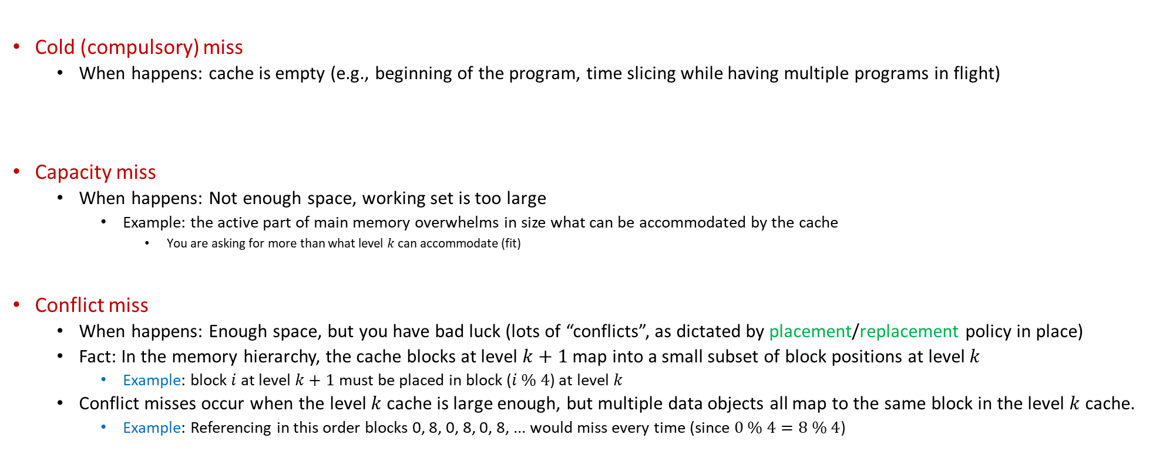
Reasons for Cache Misses
Cold (compulsory) miss
When happens: cache is empty (e.g., beginning of the program, time slicing while having multiple programs in flight)
Capacity miss
When happens: Not enough space, working set is too large
Example: the active part of main memory overwhelms in size what can be accommodated by the cache
You are asking for more than what level $k$ can accommodate (fit)
Conflict miss
When happens: Enough space, but you have bad luck (lots of “conflicts”, as dictated by placement/replacement policy in place)
Fact: In the memory hierarchy, the cache blocks at level $k+1$ map into a small subset of block positions at level $k$
Example: block $i$ at level $k+1$ must be placed in block ($i \% 4$) at level $k$
Conflict misses occur when the level $k$ cache is large enough, but multiple data objects all map to the same block in the level $k$ cache.
Example: Referencing in this order blocks 0, 8, 0, 8, 0, 8, ... would miss every time (since $0 \% 4=8 \% 4$)

Slide 45
Placement & Replacement Policies
The cache is small, while the memory that you try to cache in this cache is large
The cache: prime real estate – when somebody comes in, somebody else has to be evicted
Caching: like bringing folks from a city to live in one apartment building next to some prime attraction
“prime attraction”: the registers and the ALU/CU
placement policy: deciding in which “apartment in the building” to drop the cache line
Sometimes, there are several rooms in an apartment: which one do you assign to the new folks?
“replacement policy” – if you have Option A and Option B, which one should you choose: A or B?
You’ll kick out tenant from room A, or tenant from room B

Slide 46
Placement Policies
Policies that are common:
“When you bring a line of cache…”
You are free to place wherever (fully associative cache)
Based on the main memory address of the data, you can put it in one of 4 places (four rooms in an apartment)
Or 2 places, 8 places, or k places (for k-way associative cache)
You can only put it in one place (direct mapped cache)

Slide 47
Placement Policies: further discussion
Fully associative
Pros: you have full control which old cache line you want to kick out (you have a very flexible replacement policy)
Cons:
Higher overhead to find what you’re looking for (data can be anywhere in cache)
Higher overhead to decide whom to evict (the “victim”)
Direct mapped
Pros: very fast to find if in cache or not
Cons: might have to evict a line cache that actually sees a lot of use (no freedom at all in replacement policy)
K-way associative
Decent compromise; i.e., it yields a reasonably decent replacement policy – you have K options to choose from
Intel and AMD chips: 2, 4, 8, 16-way associative
Depends on cache level and which chip model

Slide 48
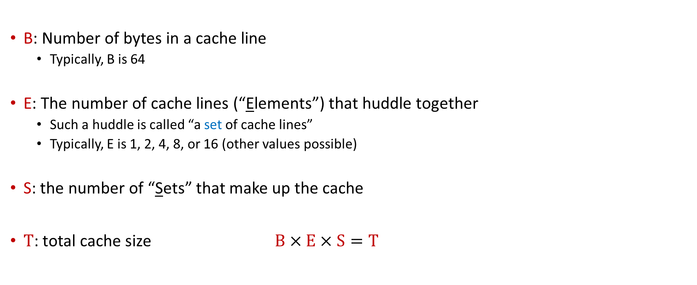
[New Topic:] General Cache Organization [Symbols Used and Their Meaning]
B: Number of bytes in a cache line
Typically, B is 64
E: The number of cache lines (“Elements”) that huddle together
Such a huddle is called “a set of cache lines”
Typically, E is 1, 2, 4, 8, or 16 (other values possible)
S: the number of “Sets” that make up the cache
$T$: total cache size $B×E×S=T$

Slide 49
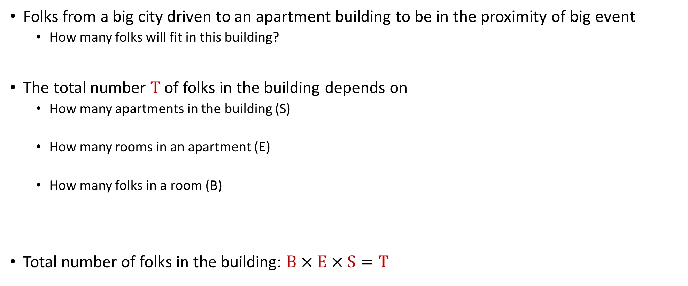
The BEST rule: The “folks in an apartment building” metaphor
Folks from a big city driven to an apartment building to be in the proximity of big event
How many folks will fit in this building?
The total number T of folks in the building depends on
How many apartments in the building (S)
How many rooms in an apartment (E)
How many folks in a room (B)
Total number of folks in the building: $B×E×S=T$

Slide 50
General Cache Organization (B, E, S)
E = 2e lines per set
a “cache Set”
a “cache Element” (it wraps inside a cache line; an element belongs to a set)
S = 2^{s} sets
Cache size:
B x E x S=T data bytes
How a “cache Element” is organized
v
tag
0
1
2
B-1
valid bit
B = 2^{b} bytes of data per cache block (cache line)
[Bryant and O‘Hallaron: CMU] →

Slide 51
On finding if data from a memory address is in cache or not
The mission: Read into register a variable at a given memory address
The important question: Is the value stored at this address by any chance in cache?
To answer this question, the addressed is partitioned in three chunks
Memory address (either 32 or 64 bits)
t bits
s bits
b bits
tag
set
index
block
offset

Slide 52
How a cache read takes place
E = 2e lines per set
Memory address (either 32 or 64 bits):
t bits
s bits
b bits
S = 2^{s} sets
tag
set
index
block
offset
data begins at this offset
How the game is played:
v
tag
0
1
2
B-1
Locate set
Check if any element in set has matching tag
Yes + line valid = hit
Locate data starting at offset
valid bit
B = 2^{b} bytes – the cache block (the data)
[Bryant and O‘Hallaron: Computer Systems - A Programmer's Perspective 3rd edition] →

Slide 53
Example: Direct Mapped Cache (E = 1)
Direct mapped: One line per set
Assume: cache block size 8 bytes (instead of 64)
Address of int:
v
tag
0
1
2
3
4
5
6
7
t bits
0…01
100
v
tag
0
1
2
3
4
5
6
7
find set
S = 2^{s} sets
v
tag
0
1
2
3
4
5
6
7
v
tag
0
1
2
3
4
5
6
7
[Bryant and O‘Hallaron: CMU] →

Slide 54
Example: Direct Mapped Cache (E = 1)
Direct mapped: One line per set
Assume: cache block size 8 bytes (instead of 64)
Address of int:
valid? +
match: assume yes = hit
t bits
0…01
100
v
tag
0
1
2
3
4
5
6
7
tag
block offset
[Bryant and O‘Hallaron: CMU] →

Slide 55
Example: Direct Mapped Cache (E = 1)
Direct mapped: One line per set
Assume: cache block size 8 bytes (instead of 64)
Address of int:
valid? +
match: assume yes = hit
t bits
0…01
100
v
tag
0
1
2
3
4
5
6
7
block offset
int (4 Bytes) that you care about is here
If tag doesn’t match: old line is evicted and replaced
[Bryant and O‘Hallaron: CMU] →

Slide 56
E-way Set Associative Cache (Here: E = 2)
E = 2: Two elements/lines per set
Assume: cache block size 8 bytes (instead of 64)
Address of short int:
2 elements per set
t bits
0…01
100
v
tag
0
1
2
3
4
5
6
7
v
tag
0
1
2
3
4
5
6
7
v
tag
0
1
2
3
4
5
6
7
v
tag
0
1
2
3
4
5
6
7
find set
v
tag
0
1
2
3
4
5
6
7
v
tag
0
1
2
3
4
5
6
7
v
tag
0
1
2
3
4
5
6
7
v
tag
0
1
2
3
4
5
6
7
S sets
[Bryant and O‘Hallaron: CMU] →

Slide 57
E-way Set Associative Cache (Here: E = 2)
E = 2: Two elements/lines per set
Assume: cache block size 8 bytes (instead of 64)
Address of short int:
compare both
t bits
0…01
100
valid? +
match: yes = hit
v
tag
0
1
2
3
4
5
6
7
tag
v
tag
0
1
2
3
4
5
6
7
block offset
[Bryant and O‘Hallaron: CMU] →

Slide 58
E-way Set Associative Cache (Here: E = 2)
E = 2: Two elements/lines per set
Assume: cache block size 8 bytes (instead of 64)
Address of short int:
compare both
t bits
0…01
100
valid? +
match: yes = hit
v
tag
0
1
2
3
4
5
6
7
v
tag
0
1
2
3
4
5
6
7
block offset
short int (2 Bytes) is here
No match:
One line in set is selected for eviction and replacement
Replacement policies: random, least recently used (LRU), …
[Bryant and O‘Hallaron: CMU] →

Slide 59
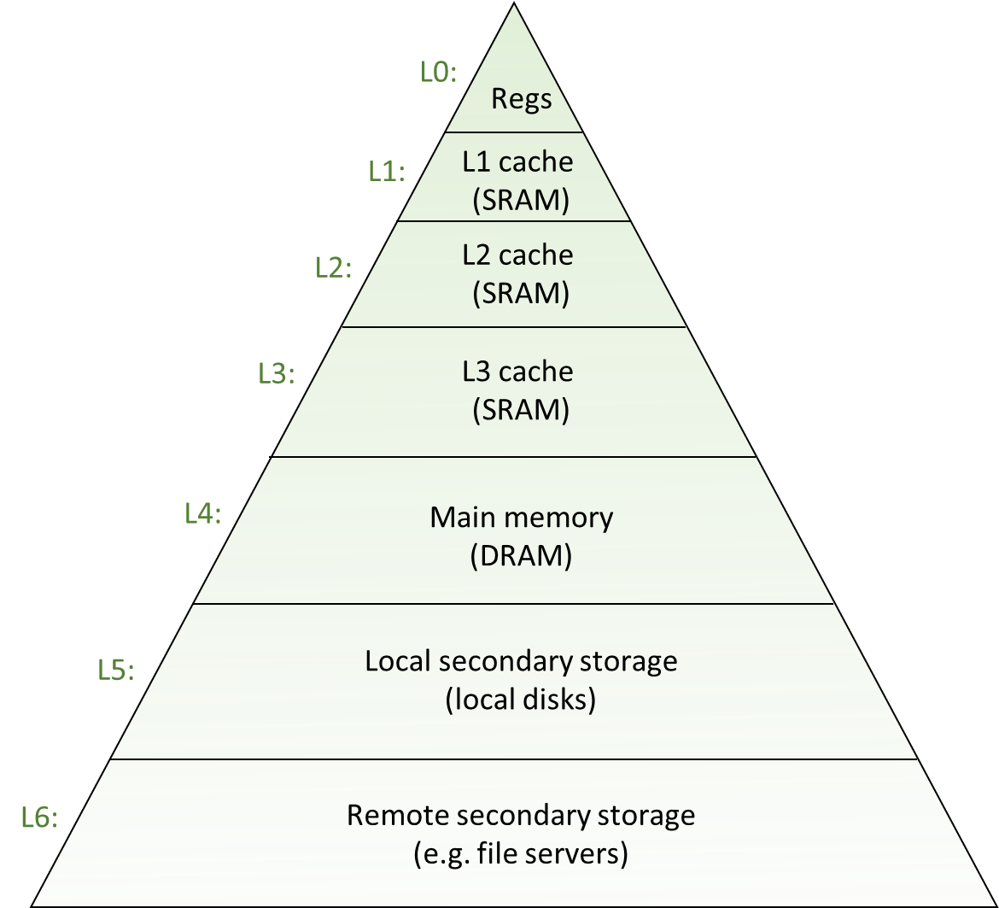
Why these acrobatics?
Trying to fit a lot of memory (system memory, GBs of it) into little memory (cache, MBs of it)
Common sense: you have to use tricks to accommodate stuff from a big pot into a small pot
This dilemma of storing a lot of information in a small space is pervasive
Due to the memory hierarchy reality we are operating under
Similar tricks for placing data in main memory relative to placing in secondary memory

Slide 60
Going on a tangent: TLP vs ILP
Chip can do more than one instruction per cycle
ILP flavor: if chip is superscalar
TLP flavor: two threads/processes run at same time, say A and B
Cache implications: TLP not positioned well
On each miss by B, the cache victimizes an approximation of the least-recently-used (LRU) cache block
Most of B’s misses will victimize blocks last accessed by A rather than last accessed by itself
Consequences:
The L1 cache turns over sufficiently fast that you can approximately assume that B victimizes all of A’s blocks
Whether the L2 is completely flushed depends on B’s rate of misses, the L2 size, and how long B runs
[Mark Hill]$→$

